Slide 1

COFFEE SHOP SALES ANALYSIS REPORT

Slide 2

Requirements
How to total orders and revenue vary by day of the week.
How do total orders and revenue vary by different locations of the store.
Determine the average sales generated per order.
Determine the average quantity sold per order.
Analyze the peak hours with respect to orders.
Examine the monthly trend for orders.

Slide 3
Requirements
Analyze the price influence on total orders and revenue.
Determine the percentage contribution of top 5 categories in terms of revenue generation.
How does size variation in percentage impact the total sales.
Determine the total selling products with respect to revenue generation.

Slide 4
Insights
Total orders come out to be 149116.
Total revenue generated is about $698812.
Average sales per order is $1.69
Average quantity sold per order is about 1.44.
Hourly trend for total orders shows most of the orders are placed in between 8 AM to 10 AM.
June is the month with highest orders.

Slide 5
Insights
The chart shows that the prices of products ranging from $2.5 to $3.75 earn the maximum revenue and orders amongst other prices.
Coffee and Tea are contributing about 71% of total sales.
Large size products are contributing about 34% to total revenue which is the maximum out of other sizes.
Barista Espresso is the most liked product by customers having total revenue of about $91,460.

Slide 6
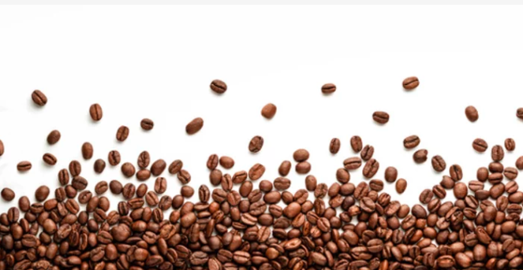
Recommendations
Based on the analysis, following recommendations are suggested for boosting the business revenue:
Customers place more orders in breakfast timings from 8 AM to 10 AM, so different promotional deals can be introduced at this time to generate more revenue.
In June, customers are likely to place more orders as compared to other months so inventory of highest revenue generating products should be maintained in order to avoid any inventory shortage.

Slide 7
Recommendations
New products can be introduced within price range of $2.5 to $3 to accelerate sales.
Large size products are more in demand by customers, so the inventory should be kept likewise.
Barista Espresso is the most revenue-generating product, thus the similar products can be offered within categories of Coffee and Tea with special discounts in order to expand the product range.

Slide 8
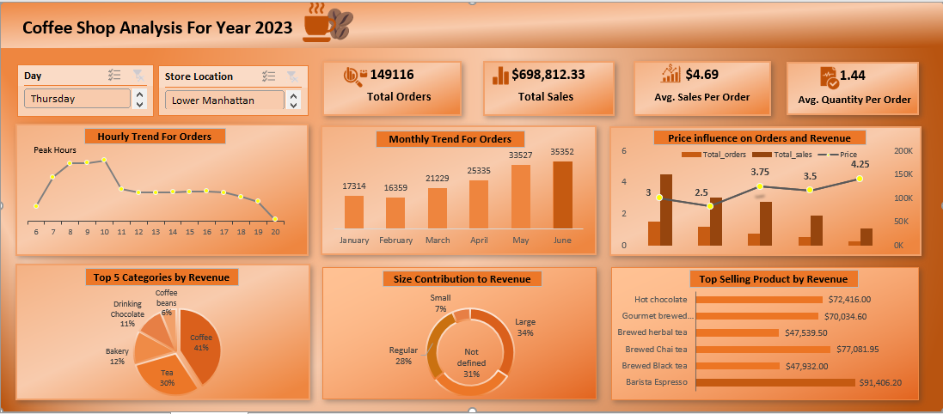
Dashboard Preview

